Slide 1
Student Record System
S R S
Project realized by :
Fopa Yuffon Amadou Olabi 154446
Hassan Amadu 154309
Kum Einstein 154312

Slide 2
Outlook On The Project
A student record linguistically is any written information about a student
Student record can be described in terms of their contents e.g. courses taken, grade point averages, personal information and others.
The maintenance of extensive, accurate, and current data about individual student is essential to the functioning of schools and can promote effective educational practices.
Some of this information most be standard.
Typical contents include family information, courses taken and other information this is use by the education system to promote student success and provide appropriate services.

Slide 3
Purpose of Student Record System
Student records are used for many important educational purpose, including
Instructions and guidance decisions;
Monitoring compliance with attendance;
And administrative purposes, such as determining tuition status, scheduling students into classes
Monitoring program completion, and completing reports for local authorities.
The student record usually contains the information necessary for each of these purposes at the school or urban level.

Slide 4
Benefits of the student record system
A well-designed student record system yields many benefits.
The most important of these is the ability to report information for decision making about individual students, school and programs.
A second benefit, particularly with automated systems, is efficiency in processing and exchanging student records among schools.
When student records are added to an overall management information system that includes information on materials, more management activities can be accomplished and efficiency will be improved.
Student record systems, thus, play a key role in the overall functioning of the education system; but more importantly, they increase a school’s ability to meet the needs of students.

Slide 5
Structure of the Project Design
We can Login in The program as Administrator or Student.
The Administrator logs in with a username and a password and have the following functions :
Add a New User (both Admin&Student);
Delete a User (both Admin & Student);
Edit a Student information;
Create, define and edit Courses;
Reset Accounts (both Admin & Student);
View of Administrator’s and Students List;

Slide 6
Structure of the project Design
The Student logs in with an ID (generated by the program when the student is created) and a password. The student can perform the following functions :
Create Himself;
Choose courses;
Edit Personal information;
View His Status on his Profile.

Slide 7
Details Of Project
Functions of Administrator
Add a new student
This function permits the administrator to add a new student that did not exist before in the student record system .The administrator uses the student’s ID.
Delete a student
The administrator can delete the entire student’s file .That is all personal information and courses.
Edit student information
The administrator can modify student’s information such as personal data and courses.

Slide 8
Details Of Project
Create and define courses
The administrator is responsible for giving the course outline for each specific program with their respective average point grading.
Reset account
In case of forgotten password the administrator can reset the students account.

Slide 9
Details Of Project
Functions of Students
Create Himself
This function permits the student to add himself that did not exist before in S R S while entering personal information.
Choose courses
The student is allowed to choose from a set of courses provided by the administrator.
View Student Status on his Profile
The Student can view his current status info's on the profile anytime he/she wishes while using S R S .
Edit Personal information
The student can edit his personal information if he/she wishes in S R S .

Slide 10
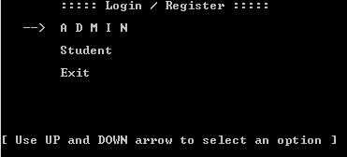
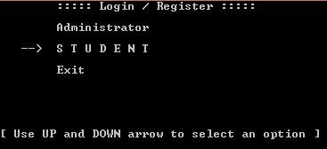
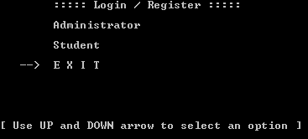
Structure of the project Design
We can Login in The program as Administrator or Student.

Slide 11
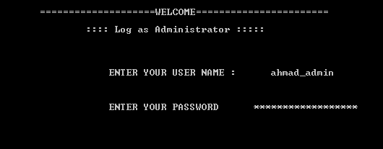
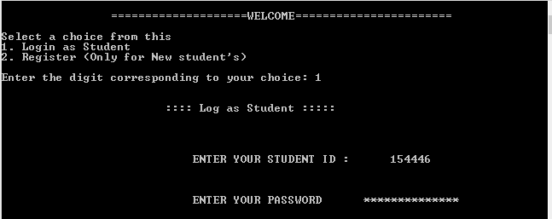
Structure of the project Design
Sample of When Login as an Administrator.
Sample of When Login as a Student.

Slide 12
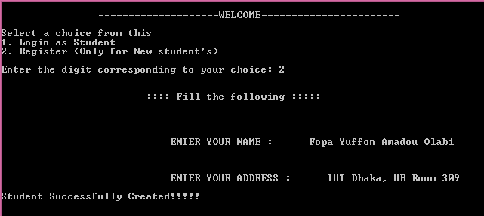
Structure of the project Design
Sample for Register a Student

Slide 13
END OF PRESENTATION
#### Thanks You ####

